Slide 1
Senior Project Final Presentation Spring 2016
Registration System 1.0
Team Members: Eduardo Guerra, Wayne Curling
Product Owner: Kip Irvine
Instructor: Masoud Sadjadi
School of Computing and Information Sciences
Florida International University
April 25th, 2016

Slide 2
Problem Definition
The Ultimate Software Academy for Computer Science Education holds programming competitions for high school student teams. In Phase 1 of this project, we would like to create an interactive web site that makes it easy for coaches and contest administrators to collaborate on the registration process.
My Part:
Account registration
Login with role based authentication
Administrator-side functionality
User Interface

Slide 3
System Design: Architecture

Slide 4
System Design: Deployment

Slide 5
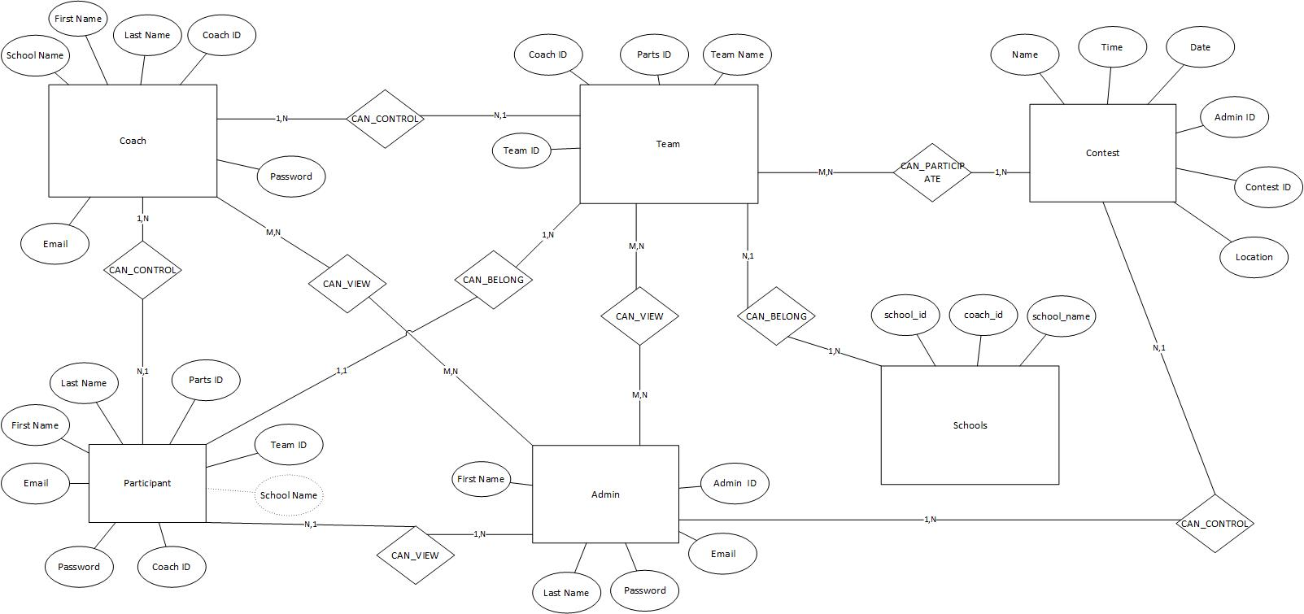
Data Design

Slide 6
Security Concerns
Since we are dealing with personal information and have input fields, we sanitized all input fields against SQL injection.

Slide 7
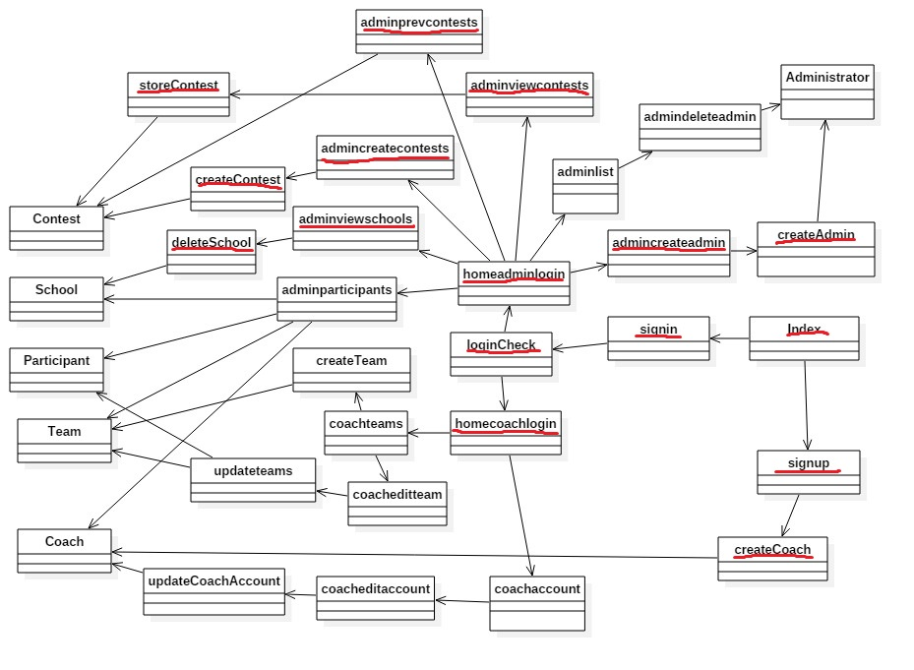
Class Diagrams

Slide 8
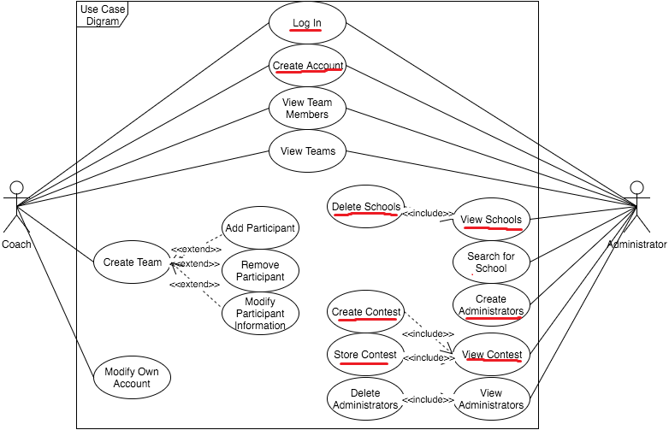
Use Case

Slide 9
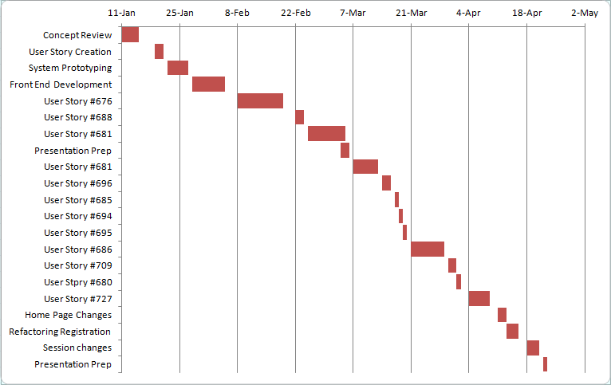
Progress

Slide 10
User Stories
#676: Create account for coach
#688: Login for coach
#681: View Teams as Admin
#685: View List of Schools as Admin
#684: View Active Contests as Admin
#695: View Stored Contests as Admin
#696: Create Contests
#680: Create Administrator Account
#686: Store Contest Data
#709: Remove Coach
#727: Remove School

Slide 11
Managing Contests
#684: View Active Contests as Admin
#695: View Stored Contests as Admin
#696: Create Contests
#686: Store Contest Data

Slide 12
Use Case for Managing Contests

Slide 13
Sequence of Events

Slide 14
Rainy Day
Test ID: RegSys_CreateContestTest01
Purpose: To test a failed contest creation on RegSys with an invalid date.
Preconditions:
1. The user must be a logged in admin.
2. The user must be able to navigate to the contest creation page.
3. The contest name, time, location, and description fields must be filled out.
Input:
1. Date = "YYYY-MM-DD"
Expected Output:
1. "This is not a valid date" message displayed.

Slide 15
Sunny Day
Test ID: RegSys_CreateContestTest02
Purpose: To test a successful contest creation on RegSys with a valid date.
Preconditions:
1. The user must be a logged in admin.
2. The user must be able to navigate to the contest creation page.
3. The contest name, time, location, and description fields must be filled out.
Input:
1. Date = "2016-03-17"
Expected Output:
1. Redirected to Active Contests page and new contest is visible.

Slide 16
Storing Contest: Interesting Algorithm
Generate a card for every contest, with the name, date, time, location, creator, and participants in every contest, along with a submit button.
When the submit button is pressed, the form is submitted, along with a hidden input that posts the id of the contest.
Execute query to set the contest with the passed ID to inactive.

Slide 17
This is for the kids
I worked on user interface, account registration, session authentication, and admin side functionality.
Email: eguer048@fiu.edu
Any Questions?
Thank you!

